Slide 1
Hands-on simulation modeling:
An N Model for Ag Systems in Iowa
https://www.nrem.iastate.edu/nmodel/
See Introductory Video
All of the natural processes (everything except N fertilizer addition) are controlled by climate, i.e. precipitation and minimum and maximum temperature. N Uptake by crops is also controlled by solar radiation.
The water cycle is so integral to N cycling, that our N model includes a water sub-model. See Model Notes on the website for more information.

Slide 2
Today’s Modeling Activity
Use Model in ‘Lab’ Mode
Part A: Learn how to use the model and explore the Law of Conservation of Mass.
Use one laptop per Team, hooked up to wall monitor.
Part B: Prep for doing Individual Activity: N Model for IA Ag
Address 3 ‘What-If’ questions, based on output from model runs.
We will work through Scenario 1 as a class.
For Scenarios 2 & 3, finish on your own, outside of class.

Slide 3
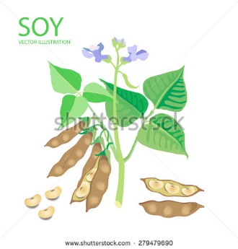
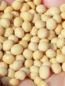
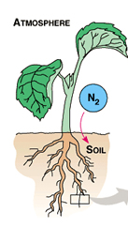

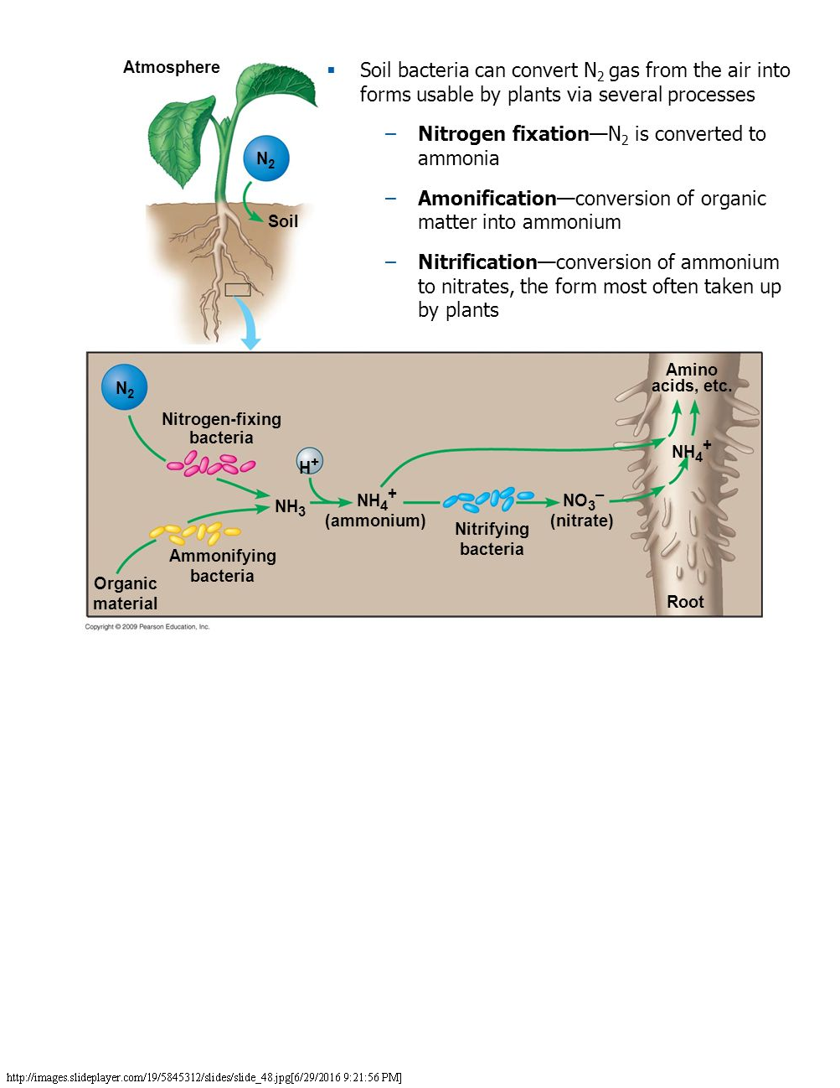
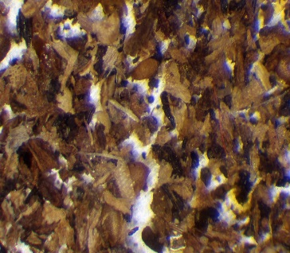
Yield
Atmosphere (light blue background)
Dinitrogen, N₂
Nitrous oxide, N₂O
Fertilizer
Riparian Buffer Strip
N Fixation
Denitrification
Inorganic N
Stream
Ammonia
Leaching
Gulf of Mexico
Assimilation
Nitrification
Nitrate
Detrital Flow
Mineralization = Ammonification
Immobilization
Soil (Tan background)
Organic N

Slide 4
The Nitrogen Cycle in an Iowa Ag System

Slide 5
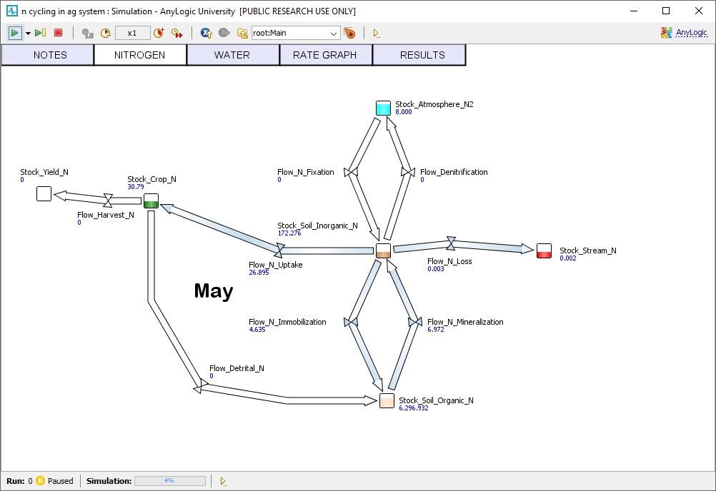
Notes:
This N model contains six stocks:
1) Atmospheric (gaseous) dinitrogen, N₂
2) Soil Inorganic N (ammonia (NH₃), ammonium (NH₄) and nitrate (NO₃))
Crop N, which at harvest time is split into
3) Yield N (harvested portion) and
4) Detrital N (residue returned to Soil Organic N);
5) Soil Organic N
6) Stream N
Plus, an optional flow to Riparian buffer strips.
The model contains seven flows:
1) N Fixation. By this process, N flows from the atmosphere to the soil. Lightning or microbes hosted in legumes such as soybean and alfalfa or free-living microbes can transform non-reactive atmospheric N₂ into reactive ammonia in air and ammonium within the Soil Inorganic N stock. This is the only natural input of N to the system. Within the soil, ammonium is converted to nitrate by the process of nitrification by microbes (not depicted in the model); nitrate is also contained in the Soil Inorganic N stock. In this model, N fertilizer additions by people are treated as an event, not a flux, but the amount of N fertilizer added is included as an input in the N budget calculations.
2) Assimilation (uptake by crops) occurs when N flows from the Soil Inorganic N stock to Crop N, mostly in the form of nitrate or ammonium.
3) Crop N flows to Harvested Yield at harvest time.
4) The remainder of the crop, Detrital N, flows to the Soil Organic N stock.
5) Immobilization occurs when Soil Inorganic N is taken up by microbes and becomes part of the Soil Organic N stock.
6) N Mineralization (= Ammonification) occurs when Soil Organic N is decomposed into Soil Inorganic N. N ‘fixed’ during N fixation can meet at least part of the crop N uptake requirement. Other crops, such as corn and oats, rely entirely on inorganic N that becomes available from N mineralization, or on fertilizer additions.
7) Denitrification, also mediated by microbes, is the process by which nitrate (Soil inorganic N) is converted to nitrous oxide or to atmospheric N₂. Nitrous oxide is a greenhouse gas, an air pollutant. 8) N leaching loss occurs when soil water leaches nitrates into groundwater and streams, polluting water onsite and downstream, all the way to the Gulf of Mexico.

Slide 6
Features of the Model:
Three cropping systems
Continuous corn
Corn-soybean rotation
Alfalfa, as a perennial
Notes:
The model contains several Management factors
1) Type of cropping system
2) Amount & timing of N fertilizer addition in kg/ha/yr
3) Other practices, including tillage type (Tilled or No-till), Cover crops, Buffer strips
4) A combination of No-till, Cover crops and Buffer strips. The model also contains a means for experimenting about climate change. To experiment, one can adjust temperature and precipitation values relative to historical means over the last 20 years.
Controls
Although not explicitly depicted, the model flows are controlled by these factors: precipitation, temperature, and crop growth stage and N fixation capacity. Climate data are from: https://mesonet.agron.iastate.edu/. Because the water cycle is so integral for N cycling, this model includes a water sub-model in which precipitation and temperature control various processes. The model is calibrated for a silty clay loam soil in a conventional agricultural system in north central Iowa from data from Russell et al. (2005, 2009).

Slide 7
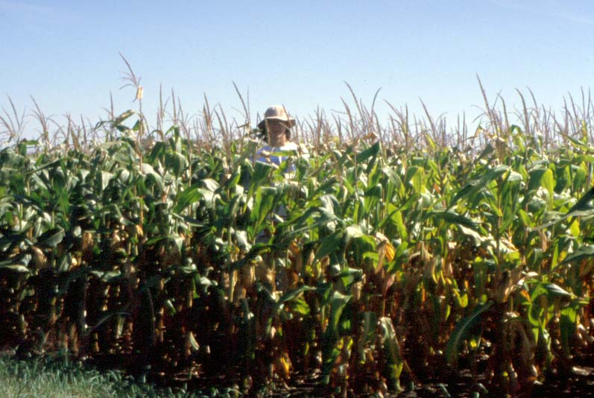
Corn
A. Russell

Slide 8

Soybean

Slide 9
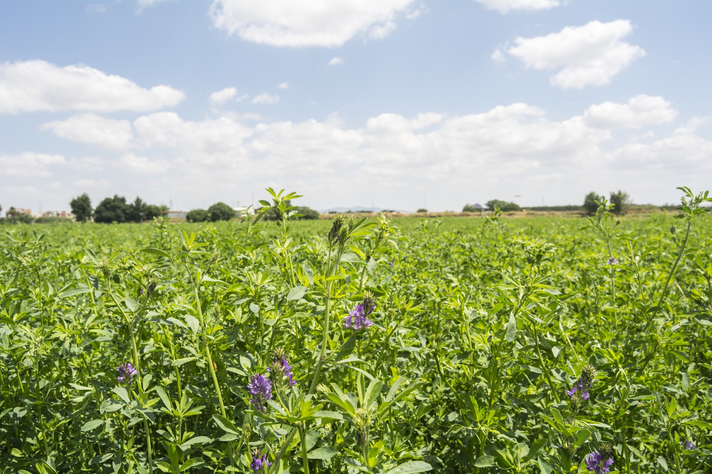
Alfalfa

Slide 10
How might different Cropping Systems affect N cycling in different ways?
Productivity can differ among crops and that affects Crop Yield
Allocation to roots vs shoots can differ
  If more goes to roots, as in a perennial crop (alfalfa), that builds up more soil organic matter.

Slide 11




Cropping Systems can affect N cycling
Tissue chemistry can differ, e.g. C:N ratio.
  This affects microbial dynamics: High C:N (corn) less decomposable than low C:N (soybean)
High C:N
Slow decomposition
Low C:N
Fast decomposition

Slide 12
Different levels of fertilizer addition
(Corn only, kg/ha/yr) & timing
None
90 in spring
90 in fall
180 in spring
180 in fall
270 in spring
270 in fall

Slide 13
Several aspects of management
Tilled
No-till
Cover Crop (rye)
Buffer strip
Combination of No-till, cover crop & buffer strip

Slide 14
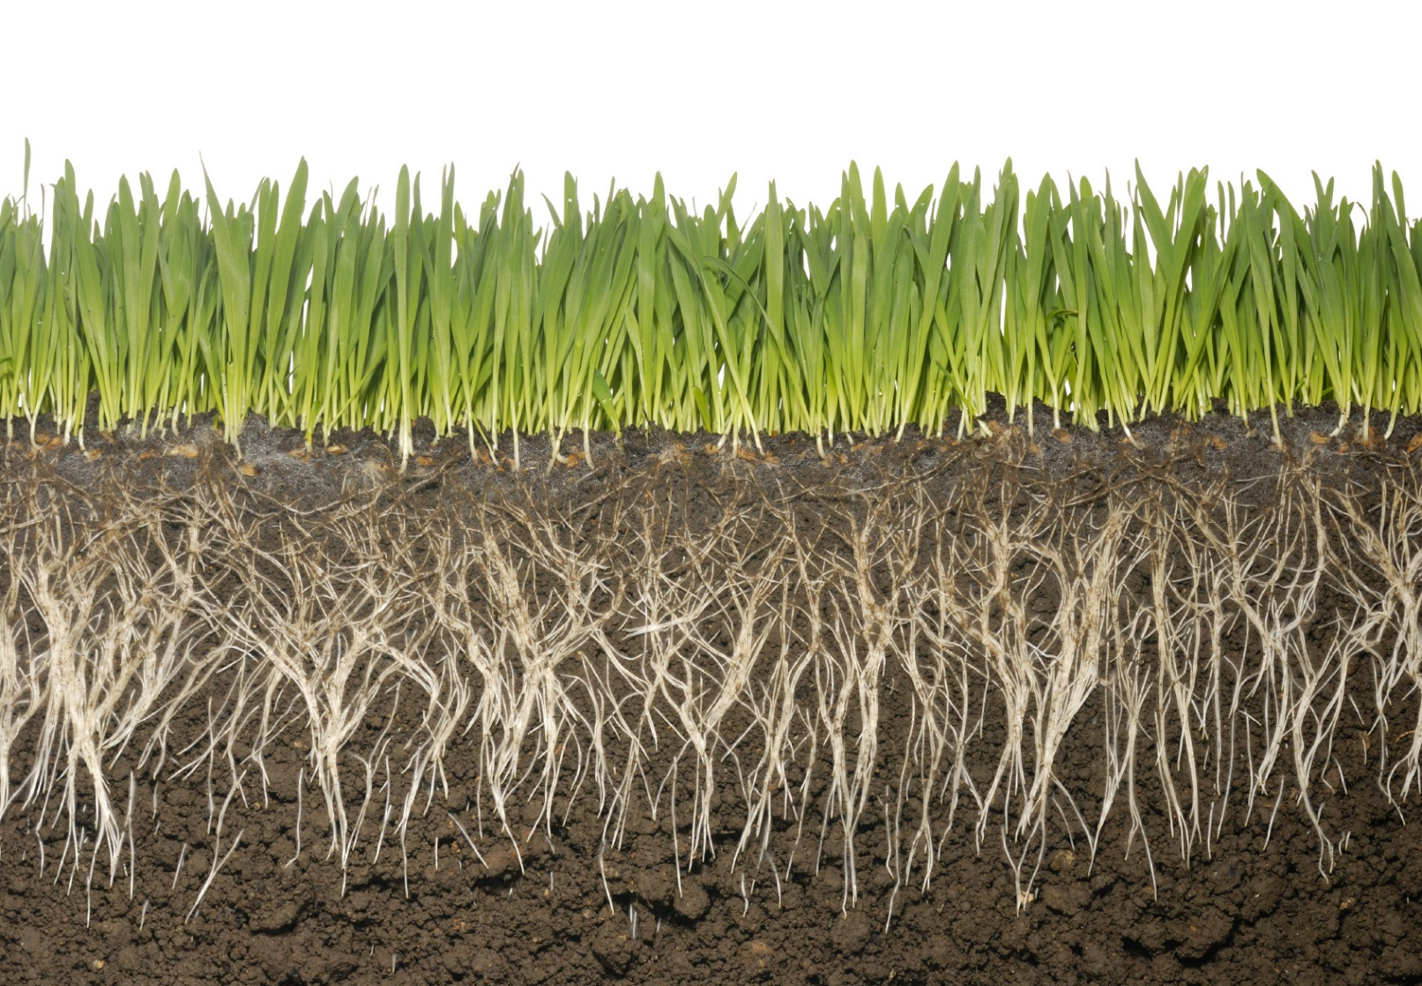
Cover Crops can reduce N flow to streams
Notice the granular soil structure of a system with a cover crop.
This promotes water infiltration and water-holding capacity.
Soils with a lower bulk density can hold more water and nutrients, and crop roots can grow better and take up nutrients more easily.

Slide 15
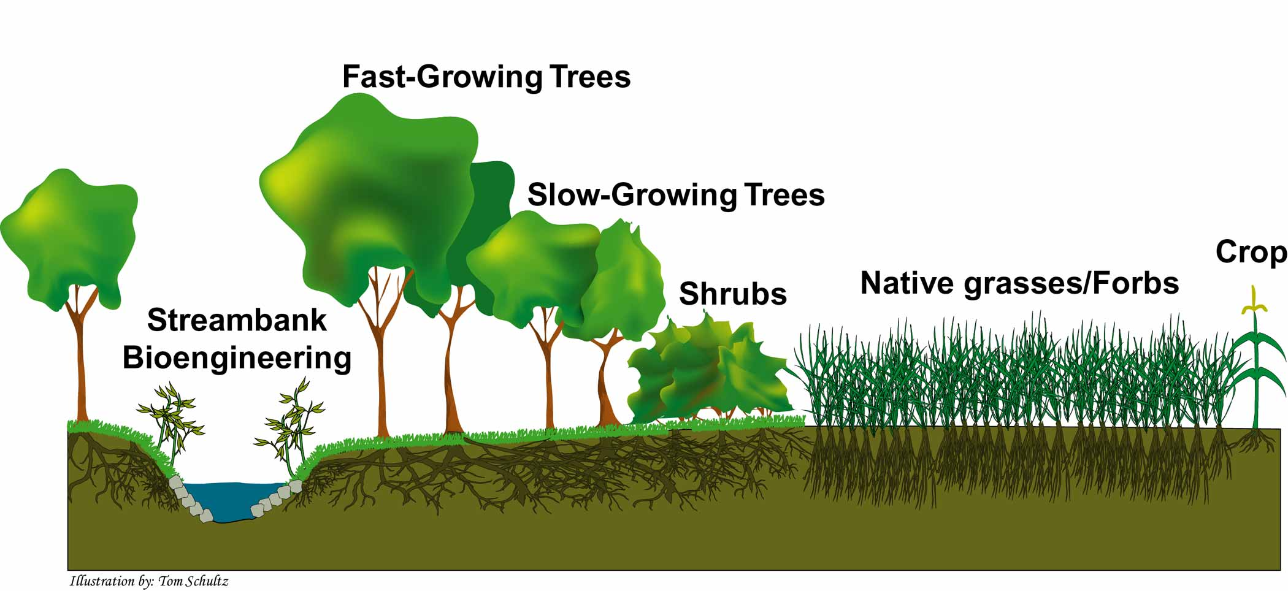
Riparian Buffer Strips can reduce N flow to streams
http://www.buffer.forestry.iastate.edu/Photogallery/illustrations/

Slide 16
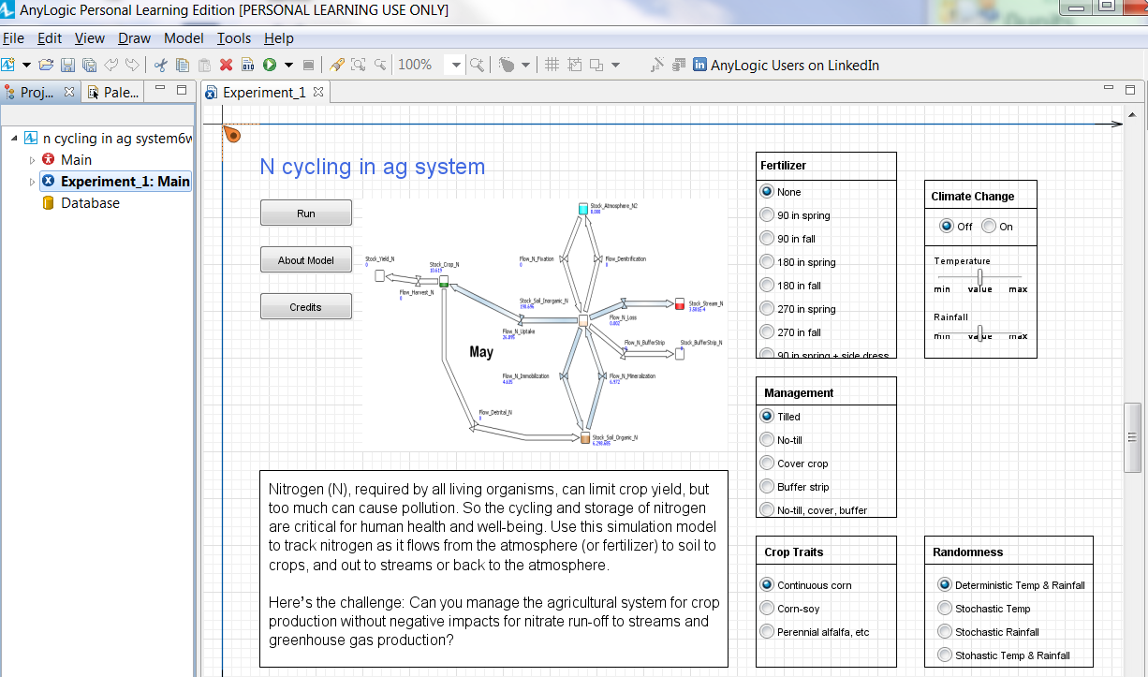

Slide 17
Part A – Law of Conservation of Mass
Open the model in ‘Lab’ mode
Set parameters: Cropping system = Continuous corn; Fertilizer = 90 in spring; Management = Tilled; Randomness = Deterministic
Open the Excel spreadsheet ‘N in IA Ag model worksheet’, Part A
  Initial stocks have been entered – Record them in Table 1
Run the model
Record values for stocks at end of the 10-yr run in spreadsheet and Table 1
Calculate difference between Final and Initial amount for each stock

Slide 18
Results

Slide 19
Interpretation
Did the N stocks within a given pool, e. g., Soil Inorganic N, differ between the Initial and Final times?
Determine whether Total N stocks, i.e., the sum of all the stocks in the whole system plus the fertilizer added, differed between the Initial and Final times. Was the difference in Total N stocks close to zero? Note: Rounding errors might cause it not to be exactly zero.
Do your data support the Law of Conservation of Mass? How does this Law enable us to construct element budgets in ecosystems
Notes:
Soil Inorganic and Organic N both decreased, while N in Crop Yield and the Stream increased. Atmospheric N did not change.
The change in total N was close to zero (-1).
Yes, assuming that the change in total N of -1 kg/ha in a pool of 15,218 kg/ha was simply the result of rounding errors. Although an element may move between pools as it undergoes chemical transformations, the total mass of it within a system remains constant – mass is neither created nor destroyed.

Slide 20
Using a model to virtually test a hypothesis
Sometimes it’s impractical to conduct an experiment in the real world.
One can develop hypotheses, based on ecological concepts, and then test them using a model.
Or, use those same concepts to pose ‘What-If’ questions under different Scenarios.

Slide 21
Experiment with the Model
Individual Activity: N Model in IA Ag
Use the model to address ‘What-If’ questions about the effects of cropping system and management.
What-If questions to explore for three Scenarios:
Scenario 1 – Effect of fertilizer: Does planting continuous corn with N fertilizer at 270 kg/ha in spring increase Yield?
Scenario 2 – Effect of perennial crop: Does planting perennial Alfalfa increase Soil Organic N stocks?
Scenario 3 – Effect of cover crop: Does planting a corn-soybean rotation (N fertilizer = 180 in spring) with management of ‘Cover Crop’ reduce N stocks in ‘N Stream’? What is the significance of this?

Slide 22
What model parameters can you change to achieve address these What-If questions?
Cropping System
N fertilizer addition
Management
For Scenario 1 – Effect of fertilizer: Does planting continuous corn with N fertilizer at 270 kg/ha in spring increase Yield?
Which parameter will you vary to address this question?

Slide 23
Basic method for addressing a question
Run the model with parameters set at a baseline. Note outcome, i.e. stocks at the end of the model run.
Then change only ONE parameter, the variable that you want to test, and run the model again.
Compare the outcomes (stocks) at the ends of the two runs. (Run times must be the same.)
How many times do you need to run the model, at a minimum, to answer the question?

Slide 24
What-If Question 1
Does planting continuous corn with N fertilizer at 270 kg/ha in spring increase Yield?
What variable will you change?
  Ans: Fertilizer level
What value will you use for the baseline run?
  Ans: 90 kg/ha in Spring
For the experimental run?
  Ans: 270 in Spring
What response variable (output) will you observe?
  Ans: Yield

Slide 25
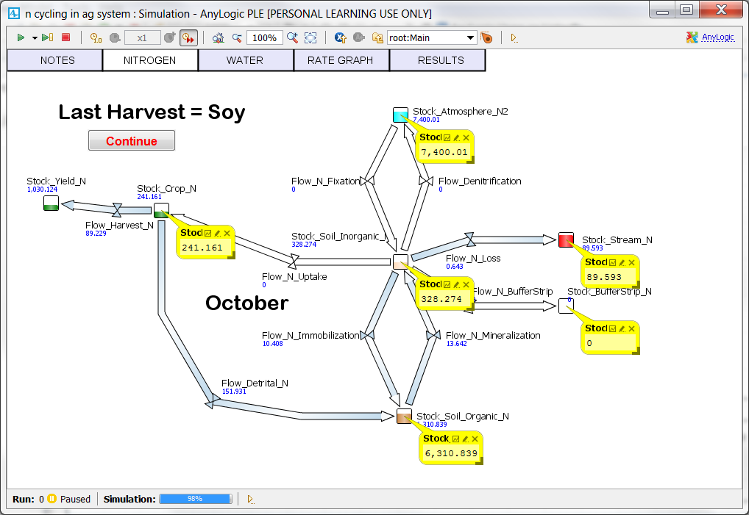
Gathering Data from the Model Run

Slide 26
Results to Record in Table 2 for Scenario 1

Slide 27
Results: Interpret the results for Scenario 1
Question 1: Does planting continuous corn with N fertilizer at 270 in spring increase Yield?
Yield increased from 1054 to 1519 kg/ha N when N fertilizer was increased from 90 to 270 kg/ha
N is an essential nutrient, and corn is a high-N-demanding crop, so N uptake and productivity, and thus yield, are linked.
Is there a limit to the increase in yield that could be achieved by adding more and more N fertilizer?
Could you address this question with more modeling runs?

Slide 28
Hope you enjoy playing with the model!

